Slide 1
10 Expert Steps for Comfortable Hammock Camping
Terry McKibben
Assistant Scoutmaster
Troop 344/9344
Pemberville, OH
troop344leaders@Gmail.com

Slide 2
What is Hammock Camping?
Hammock camping simply means you're using a hammock and a few helpful accessories to comfortably sleep outdoors overnight.
Many backpackers enjoy camping with hammocks because they are lightweight and take up little pack space.
Hammock campers enjoy a higher vantage point and are spared the discomfort of sleeping on sloped or rocky ground.
A couple of sturdy trees are all you need.

Slide 3
What You Need to Hammock Camp
You can create a DIY camping setup by adding components to your current hammock, or by purchasing a “hammock tent” system that comes with most of the items below:
A hammock, if you don’t already have one
A suspension system with wide (tree-friendly) straps
An insulating underquilt or sleeping pad (sold separately from tent systems)
A rain tarp
Some bug netting

Slide 4
Step 1: Pick the Right Hammock
There are generally two options for hammocks:
A one-person hammock will save weight and space in your pack.
A two-person will give you more room to move around and get comfortable.
For sleeping, a two-person hammock will offer optimal comfort.
The best hammocks are made with a 70D ripstop nylon material to protect against abrasions and offer enough structure to comfortably hold a few hundred pounds.

Slide 5
Step 1: Pick the Right Hammock
Invest in some solid straps for hanging your hammock.
Several companies make high-quality webbing straps that can loop around trees of varying sizes and clip to your hammock with a simple carabiner.

Slide 6
Step 2: Try It Out Before You Camp
Try It Out Before You Camp
Most camping hammocks are relatively easy to set up and take down.
However, doing so for the first time is often a little complicated.
It’s much better to practice setting your hammock up at home at least once or twice before heading into the woods.
You don’t want to be stuck fumbling with setup when it’s quickly starting to get dark!
Make sure you’re comfortable both setting it up and sleeping in it before your camping trip.
If possible, spend a night sleeping in your new camping hammock in your backyard before you camp in the wilderness.
This helps ensure you’ll get a good night sleep before you head out into the woods.

Slide 7
Step 3: Bring a Tent on Your First Hammock Outing.
Anytime you try a new method, it’s important to have a backup.
Sleeping in a hammock can feel like you’re being rocked into dreamland, but sometimes you don’t quite get the correct setup and it’s almost impossible to fall asleep.
You can switch to a tent if you find your hammock uncomfortable.
It’s better to be prepared with a backup plan than being forced to suffer a night of fitful sleep.

Slide 8
Step 4: Choose an Appropriate Spot to Set Up Your Hammock
Check with land managers to see if hammocks are allowed, and what the guidelines are.
Follow Leave No Trace principles:
Setting up 200 feet or more from a water source
Use an already established campsite.
Be sure to check for hidden hazards, such as wasp nests and poisonous plants.
Flat spots help with any late night bathroom breaks.
Sleepily exiting a hammock on a decline and falling into your tarp does not make hammock camping more fun.

Slide 9
Step 4: Choose an Appropriate Spot to Set Up Your Hammock
Because hammock camping typically requires camping underneath trees, a major danger to look out for and avoid are large overhead branches that could break.
Known as widow makers, these branches have the potential to break at any moment, especially in cold, wind, or snow.
No one wants to be a human shish kabob.

Slide 10
Step 4: Choose an Appropriate Spot to Set Up Your Hammock
Pick trees that are pretty far apart from one another so you can adjust the hang of your hammock.
Your hammock stretches farther than you might assume.
Pick healthy, robust trees (6 inches in diameter or more for most trees).
Make sure the trees you choose don’t have any signs of nests or other creatures making their homes there.

Slide 11
Step 5: Use Tree-Saver Straps
Bare ropes are a no-no because of potential damage to tree bark.
The only way to hang your hammock without hurting the trees is to use hammock tree straps.
These are also known as tree-saver straps because they minimize damage to the bark and cambium layer of the tree.
Use polyester webbing tree straps at least 0.75 inches wide (a few parks mandate 2-inch-wide straps) that go around a tree, disperse weight, and minimize girdling effects.
Strap systems also make setup a breeze—no special knots required.

Slide 12
Step 5: Use Tree-Saver Straps
Picking thick, sturdy trees makes it nearly impossible to reach your arms around the trunk to attach the anchor straps.
Wind up a little bit to get momentum on your side as you lasso the strap around the tree.
It will look like you’re hugging the tree, but it’ll work.
Once you have a strap in each hand on either side of the tree, thread the fixed end through the looped end and ratchet it down as tightly as possible.
Use a carabiner to attach your hammock to one of the loops of the anchor straps and repeat on the opposing tree.

Slide 13
Step 6: Hang Your Hammock with a Good Sag
Most people find that a hammock that’s too flat or too bent won’t be comfortable.
The ideal setup is to have the straps angle up at about a 30-degree angle toward the tree.
The low point of the hammock should be no higher than about 18 inches off the ground.

Slide 14
Step 6: Hang Your Hammock with a Good Sag
Checking the Angle
Find left tree.
Make a “gun” with your left hand
Point the gun at the hammock and move your hand near your hammock suspension.
With gun parallel to the ground the hammock suspension should touch the thumb and the top corner of the pointer finger.
If this isn’t the case, make suspension adjustments as needed.
Repeat for right tree.

Slide 15
Step 7: Set Up Rain and Bug Shelters for Your Hammock
Set up a ridgeline:
A ridgeline is a line that runs above the hammock to suspend a tarp.
The line can also be used to hang things like an organizer pocket.
Bring a length of cord that's longer than your hammock, and has enough additional length to secure around both anchor points for your hammock.
Attach the cord above your hammock, using the same anchor points.
Ridgeline height can vary, though lower is better when wind-driven rain is a possibility.
In calm weather, some people choose to put the ridgeline high enough so they can stand up under their rain tarp.

Slide 16
Step 7: Set Up Rain and Bug Shelters for Your Hammock
Secure your rain tarp.
Details vary with different models of hammock tarps, but the basic process involves keeping tension at the points where it’s touching the ridgeline, and staking it out along the perimeter of the tarp.

Slide 17
Step 7: Set Up Rain and Bug Shelters for Your Hammock
Use a bug net.
Always remember to set up mesh before you fall asleep — otherwise you’ll wake up eaten alive.
A full-length bug net can completely surround your hammock.
Access to the hammock is usually via a zippered opening at the net’s midway point.
The benefit of a closed mesh system is that it allows you to rest in your hammock or read a book with air circulation but no pestering from summertime insects.

Slide 18
Step 8: Use a Drip Line
On really rainy days, water can seep down your suspension and get your hammock wet.
To prevent this, tie a drip line on your suspension, positioned under your tarp.

Slide 19
Step 9: Sleeping Comfortably in a Hammock
Once you’ve got a good sag, you can lay diagonally across the fabric.
If your body is canted 10 to 15 degrees away from the centerline, the fabric under you will flatten out a bit and you won’t feel like the hammock is swallowing you.
You’ll be amazed at how comfortable this will feel as your head and feet drop down and your body reclines ergonomically flat across the fabric.
This is how hammocks were designed to work.

Slide 20
Step 9: Sleeping Comfortably in a Hammock
Raise Your Foot End Higher.
In some cases, your body may naturally slide to the middle of your hammock, which can sometimes be uncomfortable.
To prevent any sliding, try hanging the foot side of the hammock about 8 to 10 inches higher.
This helps keep your heavier torso from sliding into the middle.
Try a Knee Pillow.
Depending on the size of your hammock (and how tall you are), you may feel a tight ridge under your legs when lying diagonally.
This can cause hyper-extension on your knees. Ouch!
To relieve this pressure, place some padding under your knees.
Extra clothes or a small pillow would work great.
Find the Right Pillow.
Many people find that the lip of the hammock serves as a perfect-size headrest.
If that doesn’t work for you, then experiment with a small pillow or stuff sack filled with perhaps a puffy jacket.
Large pillows don’t tend to work well for most people.

Slide 21
Step 9: Sleeping Comfortably in a Hammock
Stash Your Essentials.
You can place a small stuff sack with nighttime necessities inside your hammock with you.
Another option is to put things in a gear sling accessory that sets up within arm’s reach on your ridgeline or below your hammock (inside your bug net).
Note that the area under your hammock also functions like the vestibule of a tent, offering additional covered storage for larger items like boots or your pack.

Slide 22
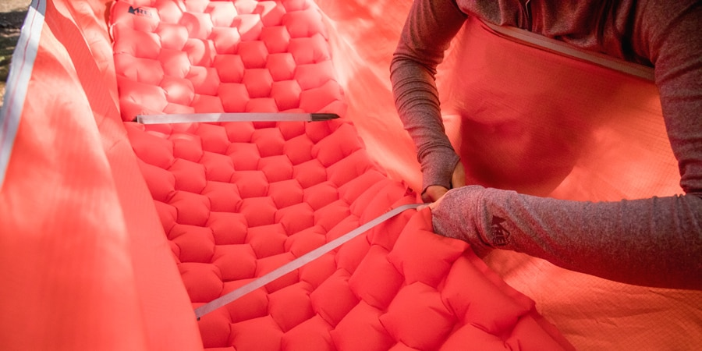
Step 10: Stay Warm with a Sleeping Pad and/or Underquilt
Whether you’re in a tent or a hammock, the underside of your lofty sleeping bag gets compressed and loses its insulation value when you lie on it.
In a tent, the solution is to use an inflated or foam sleeping pad.
You can use a pad in a hammock, too, though it might not nestle neatly into the hammock’s shape.
One option is to get an accessory sleeve to help stabilize your pad.
Another tactic is to deflate an air pad slightly to help it better conform to the shape of your hammock.
Some people take a closed-cell foam pad and cut it to fit, which is inexpensive, effective and provides wind resistance.
You can also try putting it inside your sleeping bag.

Slide 23
Step 10: Stay Warm with a Sleeping Pad and/or Underquilt
Because a hammock wraps around you, a lot of your underside is exposed to the cold.
Thus a better (albeit pricier) solution than a sleeping pad is an underquilt.
Because it hangs outside and below, an underquilt’s insulation doesn’t compress and can loft fully to provide plenty of warmth and prevent drafts from reaching your body.
An underquilt helps most during colder nights, but it’s also a great addition for windier campsites.

Slide 24
Step 10: Stay Warm with a Sleeping Pad and/or Underquilt
Sleeping in layers helps keep you warm and cozy throughout the night.
With your face exposed to the elements and the possibility of a draft in your sleeping bag, you’ll want to at least have a base layer and hat on to keep nice and toasty through the night.

Slide 25
Additional Hammock Camping Tips
When backpacking, every single ounce of extra weight matters, especially on multi-night trips.
Many of the best backpacking hammocks weigh much less than the best backpacking tents; it’s the added accessories that can up the weight.
Hammocks pack down very small and are easy to set up just about anywhere.
The exception is, of course, if you’re backpacking somewhere without trees.

Slide 26
Additional Hammock Camping Tips
Turn your hammock into a chair.
Sitting in a hammock can feel like a deep bucket seat.
This can be comfy, but if you want a chair that doesn’t cut the circulation off your knees and lets you sit up squarely, take the edge of the fabric and fold it toward the center of the hammock.
Sit down on this doubled-over area for a nice, flat seat.

Slide 27
Additional Hammock Camping Tips
With the rising popularity of hammock camping, there are now dozens of accessories you can add to your hammock setup to make it even cozier.
There are string lights to hang above the hammock for ambiance, pouches to keep smaller items close by, and portable stands in case you camp in an area where there aren’t enough trees.

Slide 28
Additional Hammock Camping Tips
Inevitably, once you wrap your straps around a few trees you’ll end up with sticky sap on your straps — and maybe even yourself.
How do you remove this small nuisance?
Any alcohol-based hand sanitizer does the trick.
Make sure to test a small section of your hammock first and then apply generously to the sap, working it in to release the sap’s grip on your hammock straps.
This is one of the more multi-use hammock camping tips; the hand sanitizer trick also works for clothing and gear to prevent tree sap from destroying everything you brought on your camping trip.

Slide 29
Additional Hammock Camping Tips
Clean your hammock regularly to increase longevity.
Dirt build-up can slowly eat away at your gear.
That’s why washing your hammock on a semi-regular basis will keep it fresh and ready to use for years to come.
Remove the carabiners, hand wash in cold water using a mild detergent, then line dry.

Slide 30
Hammock Safety
Stay safe in your hammock by following these safety guidelines:
To prevent dangerous falls, hang your hammock no more than 3 feet off the ground.
Never hang your hammock from dead trees. Dead trees are not stable enough to support your weight, plain and simple. They could break or fall, causing you serious harm and damage to the area. You should also check for falling debris. You don’t want to be hit in the head with an acorn, or worse, a dead branch, while you’re sleeping.
Do not hang your hammock over water features, chasms in the ground, or above tables or sharp objects.
Do not participate in hammock stacking, in which multiple hammocks are stacked vertically.
Just like a tent, do not keep food in your hammock.

